Slide 1
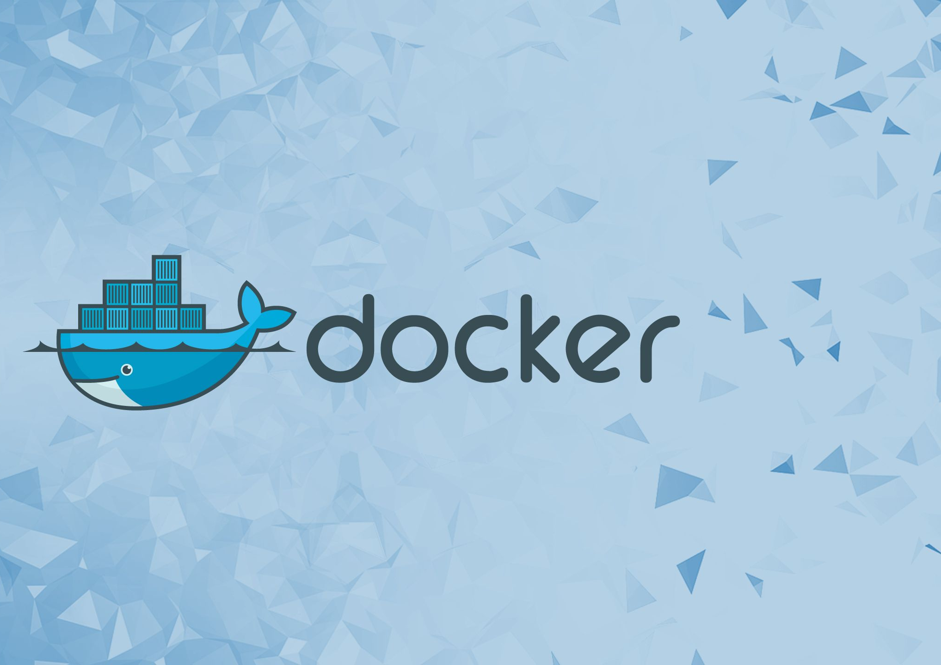
Docker Part II
Build Images

Slide 2
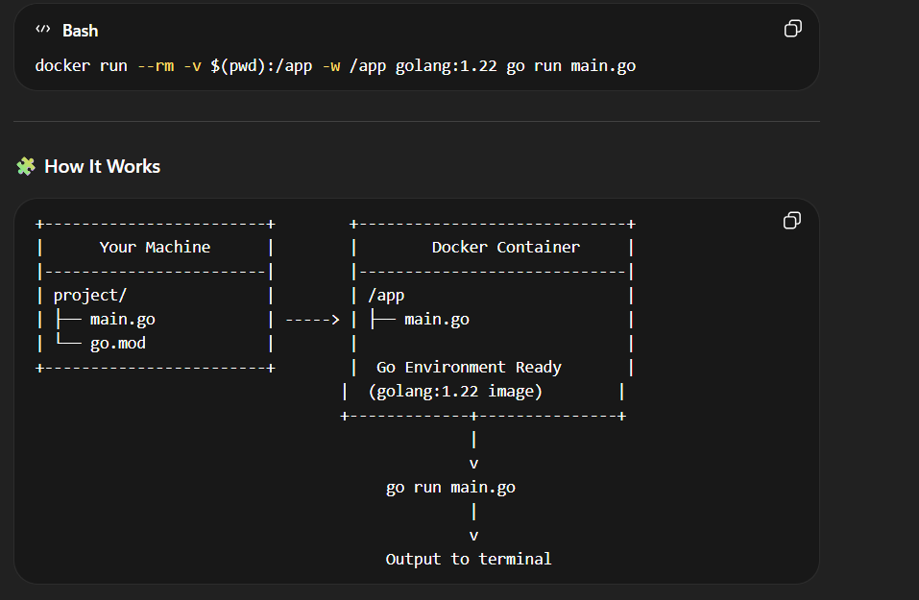
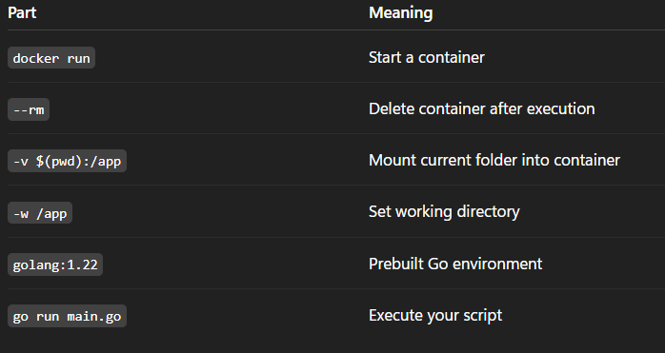
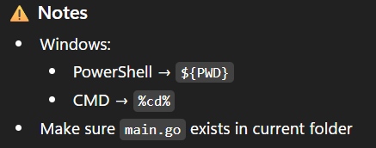
Using a container as a compiler:

Slide 3
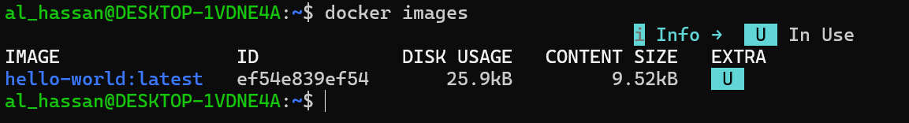
Docker Images:
A Docker image is a read-only template that contains all the instructions and files needed to create a Docker container. It packages the application code, configuration files, system libraries, and the base operating system files.
Images are built from a Dockerfile, where each instruction creates a distinct, immutable layer that defines what the image should contain or do.
To list the images you have locally downloaded, use:
To build an image from a Dockerfile in the current directory, run:
DON’T FORGET
If the base image referenced in the Dockerfile is not already on your machine, Docker automatically pulls it from Docker Hub. The best practice when using images is to use a minimal base image to reduce the size and minimize the potential attack surface commonly introduced by unnecessary packages or components.

Slide 4
Build Docker Images:
Use multi-stage builds to reduce image size and separate build-time and runtime environments. This ensures that your final image contains only what's needed to run your application, thereby improving security and performance.
Follow best practices for writing Dockerfiles to create efficient, maintainable, and secure images.
Understand how build context works in Docker, as it affects what files are sent to the Docker daemon during the build process.
Use minimal or distroless base images when possible for a more secure and predictable environment.
Validate image behavior using CI pipelines and explicitly include runtime dependencies in your Dockerfile.
Use Docker Scout to continuously monitor your images for vulnerabilities (CVEs).

Slide 5
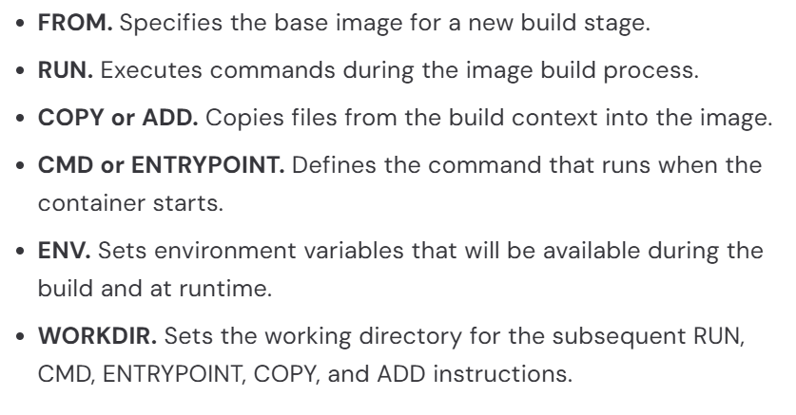
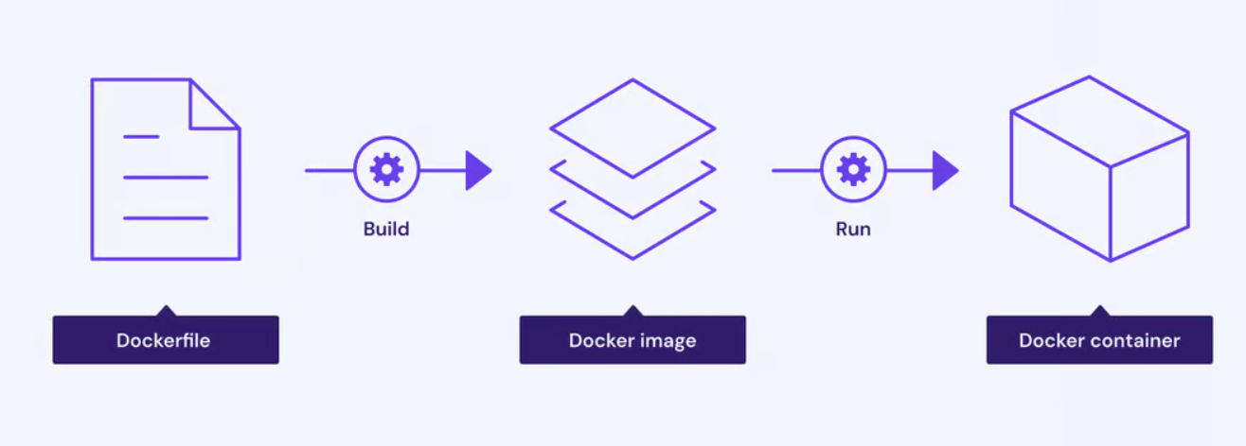
DockerFiles:
IT ALL STARTS WITH A DOCKERFILE. Docker builds images by reading the instructions from a Dockerfile. A Dockerfile is a text file containing instructions for building your source code. It defines everything from the base operating system to the environment variables and application code.
Dockerfiles are crucial inputs for image builds and can facilitate automated, multi-layer image builds based on your unique configurations. Dockerfiles can start simple and grow with your needs to support more complex scenarios.

Slide 6
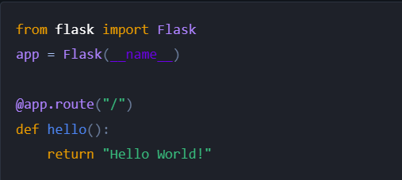
Create A DockerFile:
Filename. The default filename to use for a Dockerfile is Dockerfile, without a file extension. Using the default name allows you to run the docker build command without having to specify additional command flags.
Docker Images. Docker images consist of layers. Each layer is the result of a build instruction in the Dockerfile. Layers are stacked sequentially, and each one is a delta representing the changes applied to the previous layer.
To ship and deploy this application without Docker Build, you would need to make sure that:
The required runtime dependencies are installed on the server
The Python code gets uploaded to the server's filesystem
The server starts your application, using the necessary parameters

Slide 7
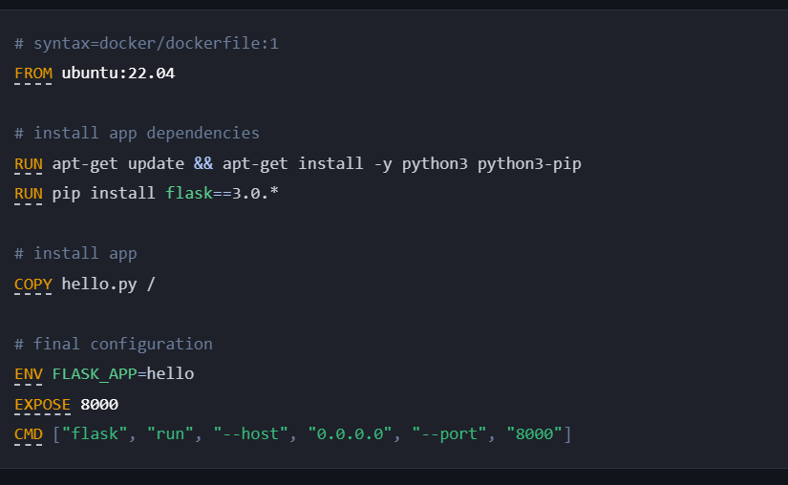
Create A DockerFile:
The following Dockerfile creates a container image, which has all the dependencies installed and that automatically starts your application.

Slide 8

Create A DockerFile:
which always points to the latest release of the version 1 syntax.
Dockerfile syntax:
The first line to add to a Dockerfile is a # syntax parser directive. While optional, this directive instructs the Docker builder what syntax to use when parsing the Dockerfile, and allows older Docker versions with BuildKit enabled to use a specific Dockerfile frontend before starting the build. Parser directives must appear before any other comment, whitespace, or Dockerfile instruction in your Dockerfile, and should be the first line in Dockerfiles.
Base Image:
The FROM instruction sets your base image to the 22.04 release of Ubuntu. All instructions that follow are executed in this base image: an Ubuntu environment. The notation ubuntu:22.04, follows the name:tag standard for naming Docker images. When you build images, you use this notation to name your images. There are many public images you can leverage in your projects, by importing them into your build steps using the Dockerfile FROM instruction.

Slide 9



Create A DockerFile:
which always points to the latest release of the version 1 syntax.
Environment setup:
This RUN instruction executes a shell in Ubuntu that updates the APT package index and installs Python tools in the container.
Installing dependencies:
The second RUN instruction installs the flask dependency required by the Python application. A prerequisite for this instruction is that pip is installed in the build container. The first RUN command installs pip, ensuring that we can use it to install the Flask web framework.
Copying files:
The next instruction uses the COPY instruction to copy the hello.py file from the local build context into the root directory of our image. A build context is the set of files that you can access in Dockerfile instructions, such as COPY and ADD. After the COPY instruction, the hello.py file is added to the filesystem of the build container.

Slide 10



Create A DockerFile:
which always points to the latest release of the version 1 syntax.
Setting environment variables:
If your application uses environment variables, you can set environment variables in your Docker build using the ENV instruction.
Exposed ports:
The EXPOSE instruction marks that our final image has a service listening on port 8000. This instruction isn't required, but it is a good practice and helps tools and team members understand what this application is doing.
Exposed ports:
Finally, CMD instruction sets the command that is run when the user starts a container based on this image. This command starts the flask development server listening on all addresses on port 8000. The example here uses the "exec form" version of CMD. It's also possible to use the "shell form":
docker build -t test:latest .

Slide 11
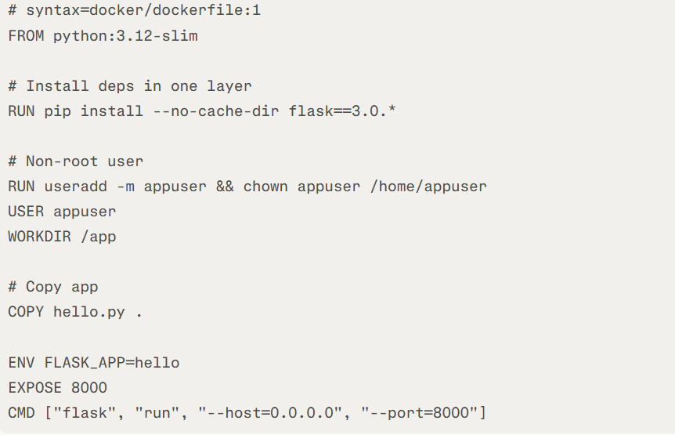

Create A DockerFile (Better Version):
Aspect | Original (Yours) | Optimized Version
Base Image | ubuntu:22.04 (~77MB, full OS) | python:3.12-slim (~50MB, Python-ready) docker​
Layer Efficiency | 2 RUNs (apt + pip = more layers/cache misses) | 1 RUN for pip (fewer layers, faster rebuilds) docs.docker​
Security | Runs as root | Non-root appuser (best practice) oneuptime​
WORKDIR/COPY | Missing WORKDIR, incomplete COPY | Sets /app, copies to it cleanly
Pip Flags | None (bloats cache) | --no-cache-dir (smaller image) docker​
Size/Speed | Larger (~200MB+), slower | ~120MB, quicker builds/runs sysdig​
You can skip it now

Slide 12
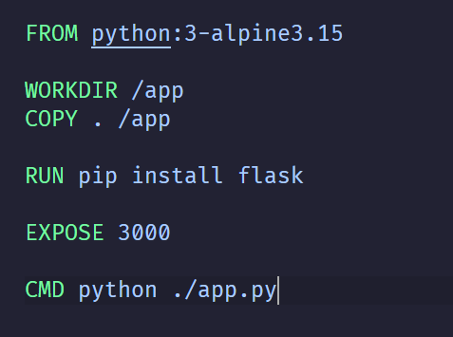
Create A DockerFile (Better Version):

Slide 13
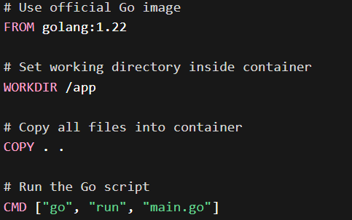
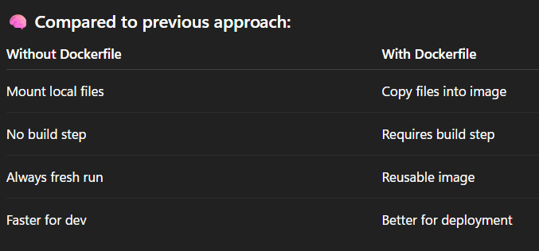


Using a container as a compiler:

Slide 14
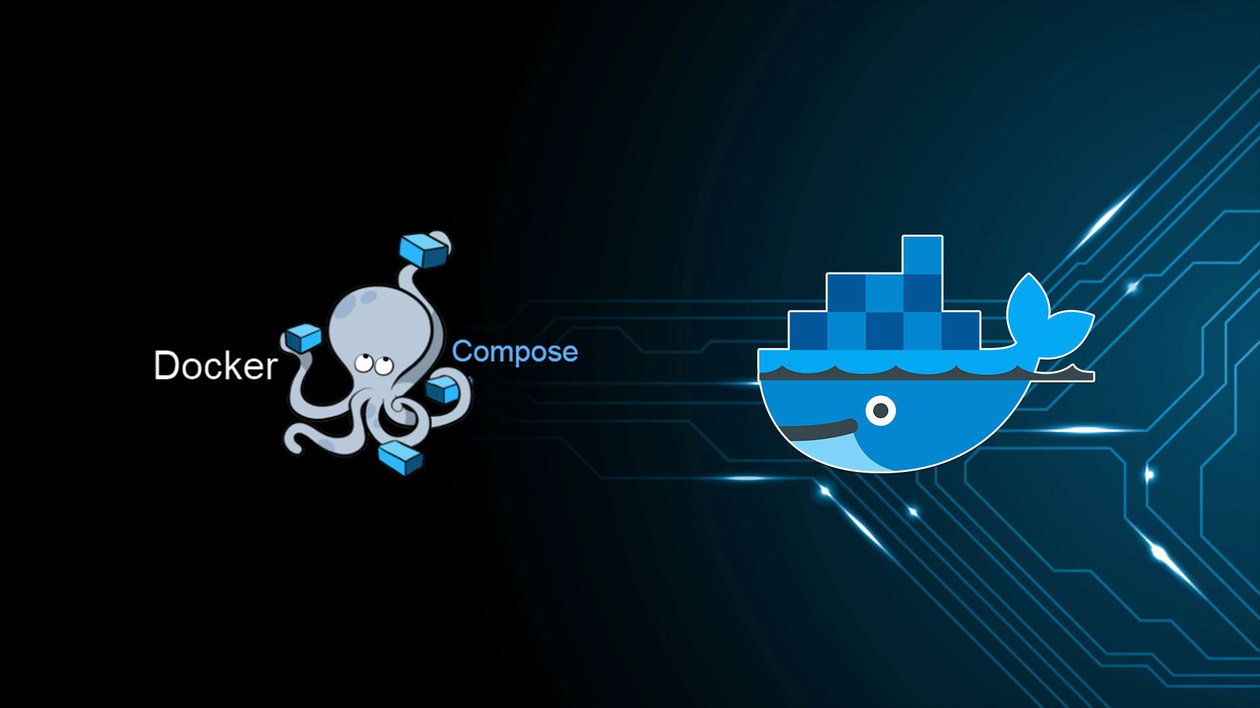

Slide 15
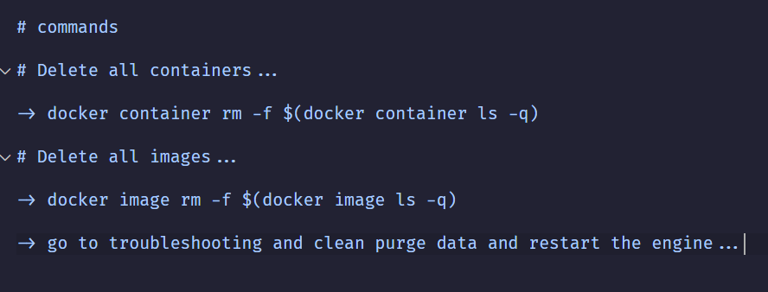
Clean Up Your Space:
Remove all the images and containers

Slide 16
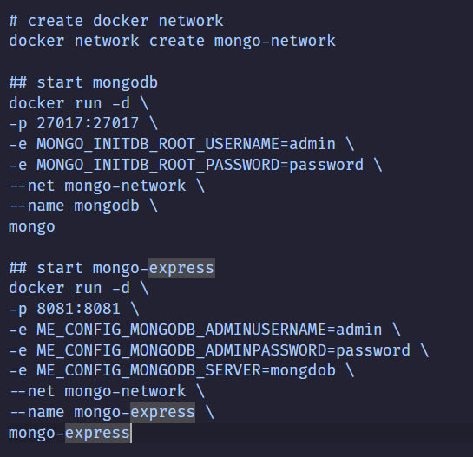
Run mongo-press:
To run multiple services like mongo-press you need to go through some steps:
1- Create a docker network
2- start mongodb container
3- start mongo-press container

Slide 17
Docker Compose:
Docker Compose is a tool for defining and running multi-container applications. It is the key to unlocking a streamlined and efficient development and deployment experience.
Compose simplifies the control of your entire application stack, making it easy to manage services, networks, and volumes in a single YAML configuration file. Then, with a single command, you create and start all the services from your configuration file.
Using Docker Compose offers several benefits that streamline the development, deployment, and management of containerized applications:
Simplified control: Define and manage multi-container apps in one YAML file, streamlining orchestration and replication.
Efficient collaboration: Shareable YAML files support smooth collaboration between developers and operations, improving workflows and issue resolution, leading to increased overall efficiency.
Rapid application development: Compose caches the configuration used to create a container. When you restart a service that has not changed, Compose reuses the existing containers. Re-using containers means that you can make changes to your environment very quickly.
Portability across environments: Compose supports variables in the Compose file. You can use these variables to customize your composition for different environments or different users.

Slide 18
Why Docker Compose:
One best practice for containers is that each container should do one thing and do it well. While there are exceptions to this rule, avoid the tendency to have one container do multiple things.
You can use multiple <docker run> commands to start multiple containers. But you'll soon realize you'll need to manage networks, all of the flags needed to connect containers to those networks, and more. And when you're done, cleanup is a little more complicated.
With Docker Compose, you can define all of your containers and their configurations in a single YAML file. If you include this file in your code repository, anyone that clones your repository can get up and running with a single command.
A Dockerfile provides instructions to build a container image while a Compose file defines your running containers. Quite often, a Compose file references a Dockerfile to build an image to use for a particular service

Slide 19
Docker Compose Core Concepts:
Services. They are the containers used in the app like front-ends (node), databases (MYSQL), and APIs(flask).
Images vs Build. Now the containers are either pre-defined images or user-defined images with Dockerfiles.
Ports, where you apply port binding for your app.
Volumes. Persist data (important for databases) (local temp files).
Networks. Allow containers to talk using service names (no IP needed).
Environment Variables. Pass config like DB credentials.
Depends_on. Control startup order (not readiness!).

Slide 20
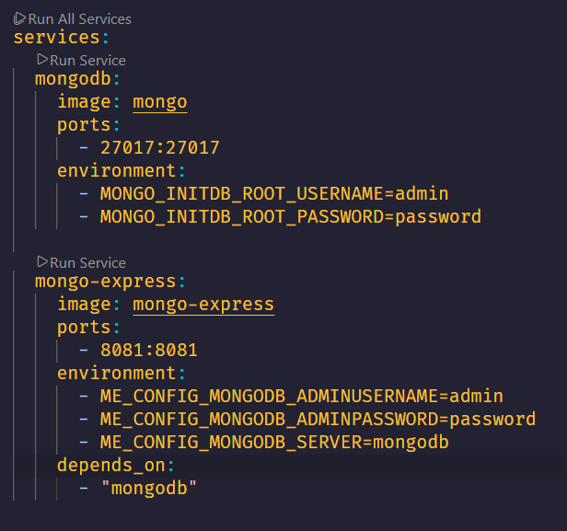
Run mongo-press:

Slide 21
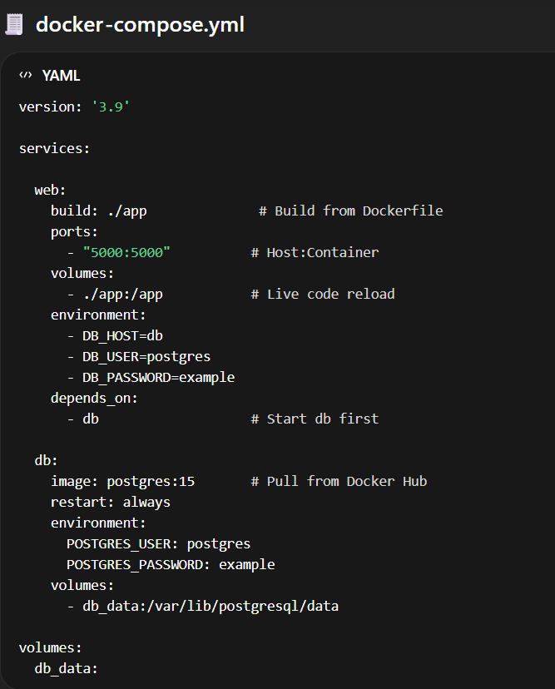
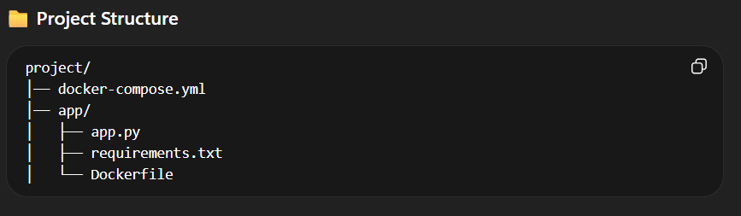
FLASK + PostgreSQL APP:

Slide 22
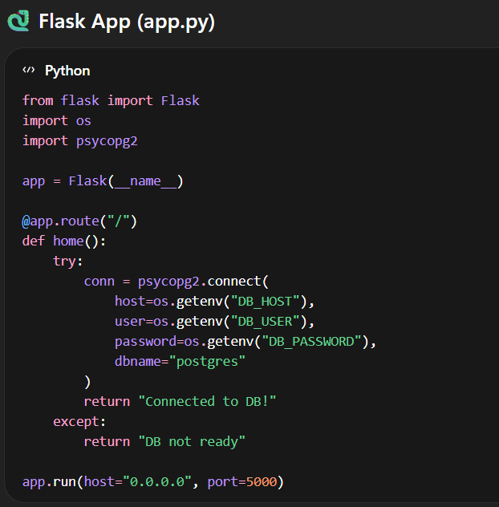
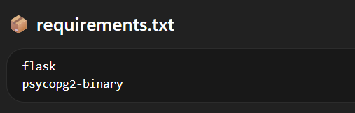
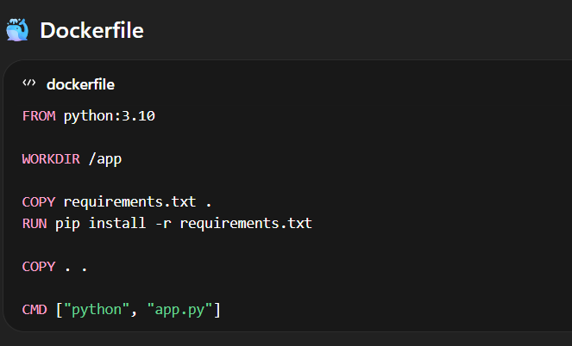
FLASK + PostgreSQL APP:

Slide 23
Docker Compose Limitation:
Well-suited for local development and small-scale deplyments.
Designed to run containers on a single host system.
Engineers still need to operate the containers manually.
KUBERNETES TO THE RESCUE.
Can manage large-scale apps and containers deployed across multiple nodes.
Has Auto-scaling and Auto-healing properties.

Slide 24
References:
https://docs.docker.com/
https://docs.docker.com/compose/
https://www.youtube.com/watch?v=DM65_JyGxCo
https://www.youtube.com/watch?v=HG6yIjZapSA
https://www.youtube.com/watch?v=SXwC9fSwct8
Section Record:
https://drive.google.com/file/d/1ohI4za_hLQKl-scnVjBSpX0Dd2LkR-ci/view?usp=sharing

Slide 25
THANK YOU

